Slide 1





Training Overview
NxN Salesforce Commercial
Process Training
From lead intake to active customer management —
one connected commercial journey.
Lead
Qualification
Conversion
Opportunity
Quote
Contract
Active Customer

Slide 2









Why this training matters
Training Scope
End-to-End Commercial Lifecycle
Salesforce creates one standard way of working across the NxN commercial journey — improving process clarity, data quality, governance, reporting, and commercial control.
1
Lead
Qualification
2
Conversion
Account / Contact
Consistency
One structured path from prospect to active customer.
3
Opportunity
Quote
Contract
4
Closed Won / Lost
Control
Stage-based governance ensures business readiness.
Customer Lifecycle
Visibility
Track lead quality, pipeline, and active/dormant status.

Slide 3


The full customer journey
Blocked
Active
Dormant
Closed Won
1
2
3
4
5
6
7
8
Lead Intake
Verification
Qualification
Conversion
Account Setup
Opportunity
Quote
Contract
Closed Lost
New prospect enters
Confirm company identity
Assess fit & viability
Create correct structure
Parent & Entity Child
Commercial stages
Prepare commercial offer
Binding agreement

Slide 4
Roles
Role Ownership
Sales
Account Manager
Lead & Qualification
Active follow-up
Opportunity progression
Dormancy awareness
CRM / Governance
Approvers / Leadership
Duplicate review
Pricing approvals
Hierarchy governance
Contracting approvals

Slide 5


Lead management essentials
Lead Management
New
Contacted / Verification
Qualified
/ Disqualified
Trusted: Route direct
Untrusted: Route to verification
Qualification Framework
Company Identity
Stakeholder
Need / Use Case
Commercial Fit
Viability
Assignment Queues
New Queue
Contacted Queue
Qualified Queue
Disqualified Queue

Slide 6
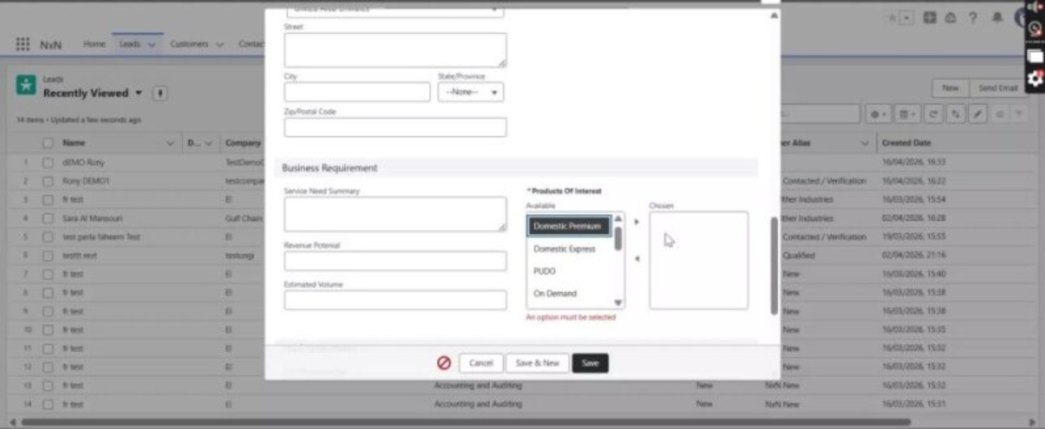
SALESFORCE DEMO
Lead Demo in Salesforce
We will switch to Salesforce to show lead intake, qualification, and the handoff into conversion.
Lead intake
Qualification
Convert
We will now move into Salesforce to show the process live and connect this training flow to the system experience.

Slide 7







Conversion & hierarchy + account lifecycle
Net-new customer group
Account Lifecycle
Create Parent Create NxN Child Create Opportunity on Child
Existing group / no NxN child
Onboarding
Match Parent Create NxN Child Create Opportunity on Child
Initial account structure and setup
Existing NxN child customer
Match Parent & Child Create new Opportunity only
Active
Ongoing commercial relationship
Partner-led opportunity
Return
to Active
Match/create partner structure Create opportunity per governance
Dormant
Account Structure Comparison
Inactive but retained for future
7X Parent Account
Entity Child Account
Contact
One per group. Reporting only. No commercial activity.
Must reference Parent.
All commercial activity here.
Stakeholders used for comms & approvals.
Blocked
Restricted from commercial activity

Slide 8
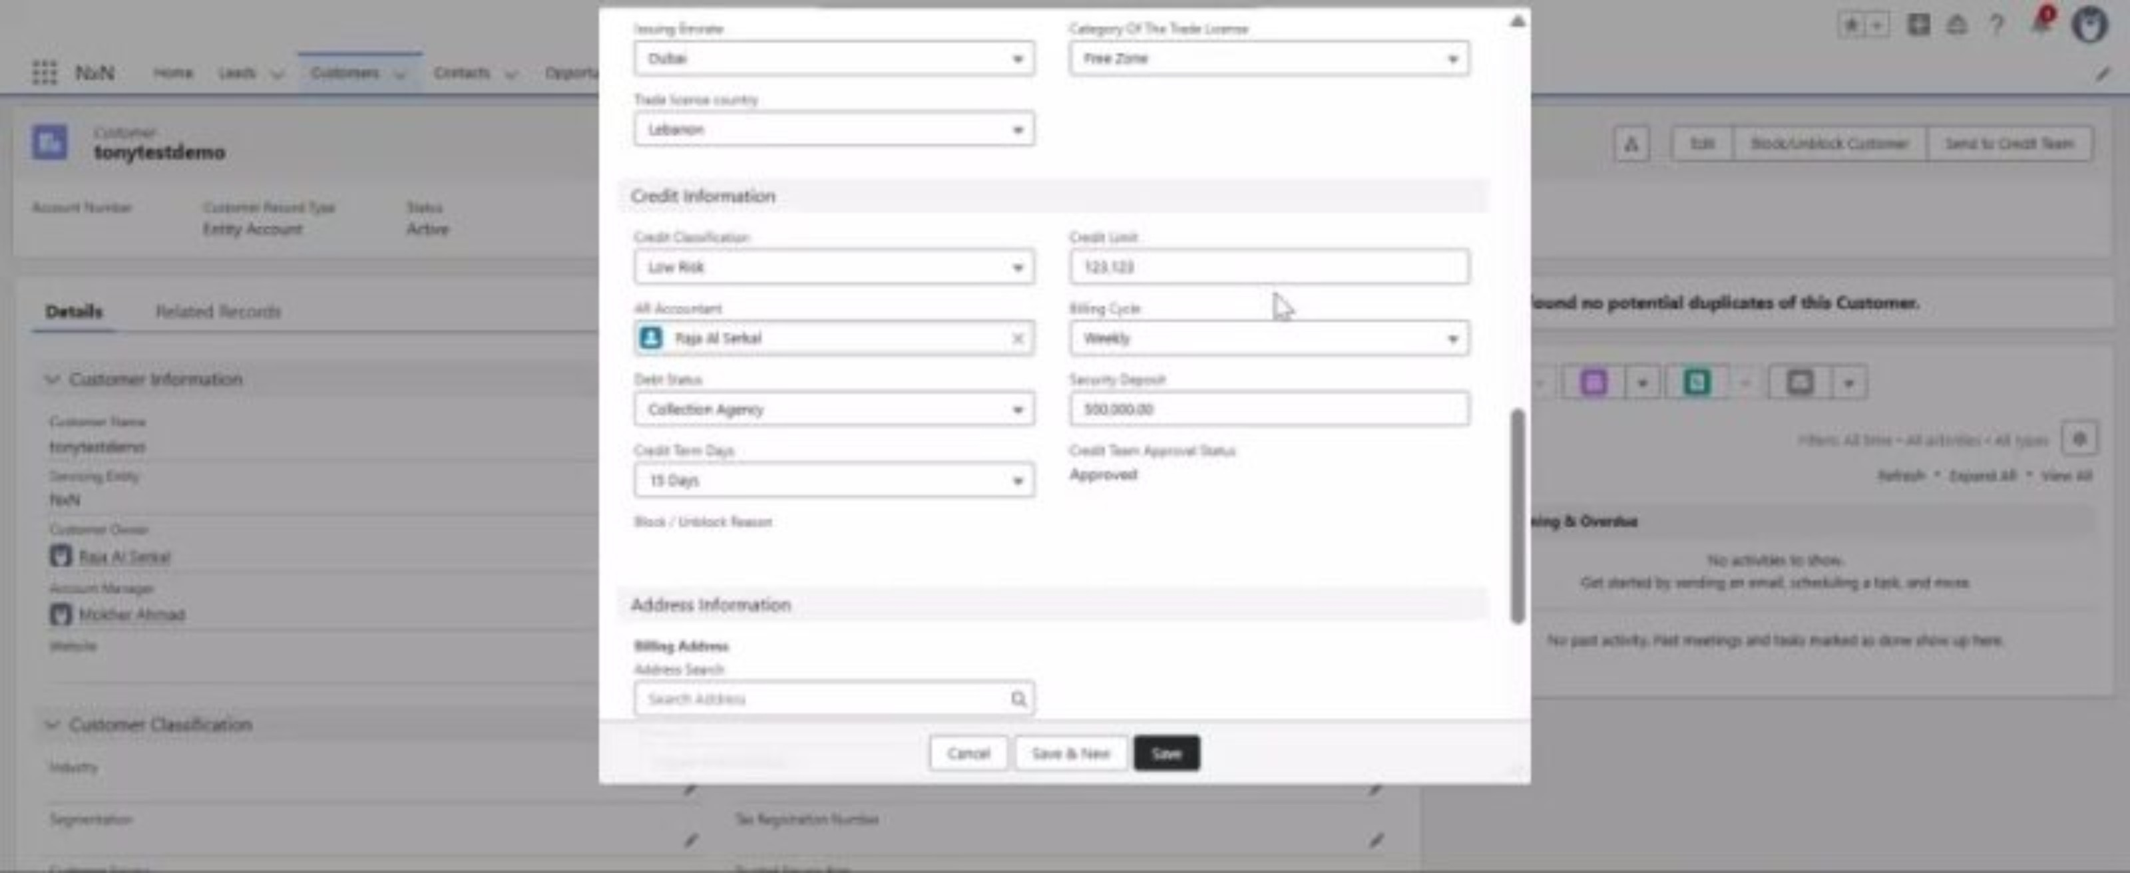
SALESFORCE DEMO
Account Demo in Salesforce
Next, we will show account conversion, hierarchy setup, and lifecycle management directly in Salesforce.
Account
Structure
Lifecycle
We will now move into Salesforce to show the process live and connect this training flow to the system experience.

Slide 9



Opportunity flow + stage gates + Quote ≠ Contract
Opportunity Stages
Stage Gate Readiness
Quote ≠ Contract
To Solution Definition
Qualification
Primary Contact + Next Step + basic scope
Actionable B2B deal exists
Quote
Solution Definition
To Pricing & Quotation
Commercial offer & scope
Scope & dependencies defined
Products/services + pricing basis + stakeholders
Pricing and discount approvals
Version control during negotiation
Pricing & Quotation
To Customer Review
Terms & quote prepared
Complete quote + discount approvals + terms
IS NOT
Customer Review
Negotiation & cycles
To Contracting
Approved quote/basis + customer alignment
Contract
Contracting
Binding agreement ready
Close Won
Legal / binding agreement
Signed contract / approved acceptance evidence
Separate lifecycle status
Closed Won
Required before activation
Accepted offer
Closed Lost
Close Lost
Not viable/selected
Loss reason mandatory

Slide 10
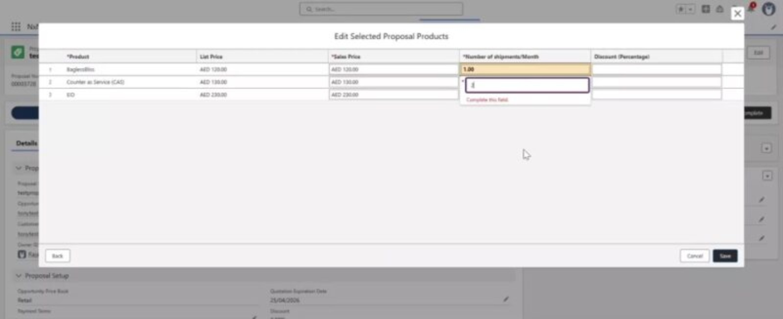
SALESFORCE DEMO
Opportunity, Quote & Contract Demo
Finally, we will walk through how opportunities progress into quotation and contract readiness in Salesforce.
Opportunity
Quote
Contract
We will now move into Salesforce to show the process live and connect this training flow to the system experience.

Slide 11
Governance, reporting, and final recap
Governance
Reporting Outcomes
Duplicate Management
Matching rules & warning/block logic
Lead Volume
Conversion Rates
Cycle Time
Data stewardship protection
By source & trust class
Stage progression metrics
By stage and by source
Duplicate Review Flow
Pipeline Analysis
Quote-to-Win
Win/Loss Analysis
Detect potential duplicate
Stage, Bucket, Entity, Owner
Approval turnaround & perf
Reasons & competitor data
Governance decides merge/match/confirm
Security & Competition-Safe
Contract Metrics
Customer Lifecycle
NxN users see only NxN data
Cycle time, turnaround, active coverage
Active vs Dormant, acquisition, retention
Avoid exposing restricted details
Full-Cycle Simulation Recap
1. Lead → 2. Verification → 3. Qualification → 4. Conversion → 5. Account & Contact → 6. Opportunity →
7. Stage Gates → 8. Quote → 9. Contracting → 10. Signed/Accepted → 11. Closed Won → 12. Active Customer
Wrong Way To Avoid:
Qualifying early, missing reasons, Quote=Contract, selling on Parent, skipping gates.
Start with Lead | Qualify with evidence | Convert correctly | Sell on Entity Child | One Opp per Bucket | Quote ≠ Contract | Keep data clean

